Slide 1
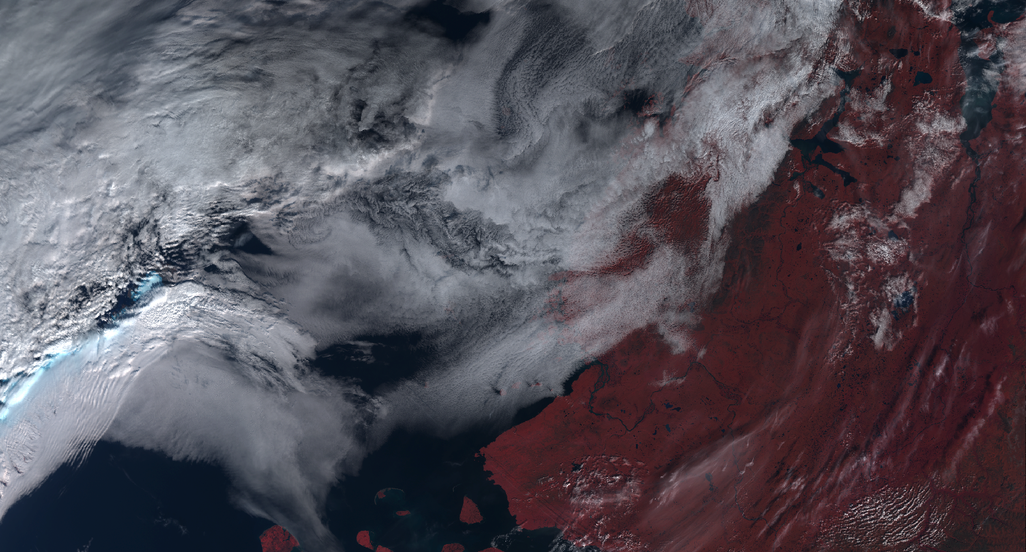
Material for Meeting
14th January 2019

Slide 2
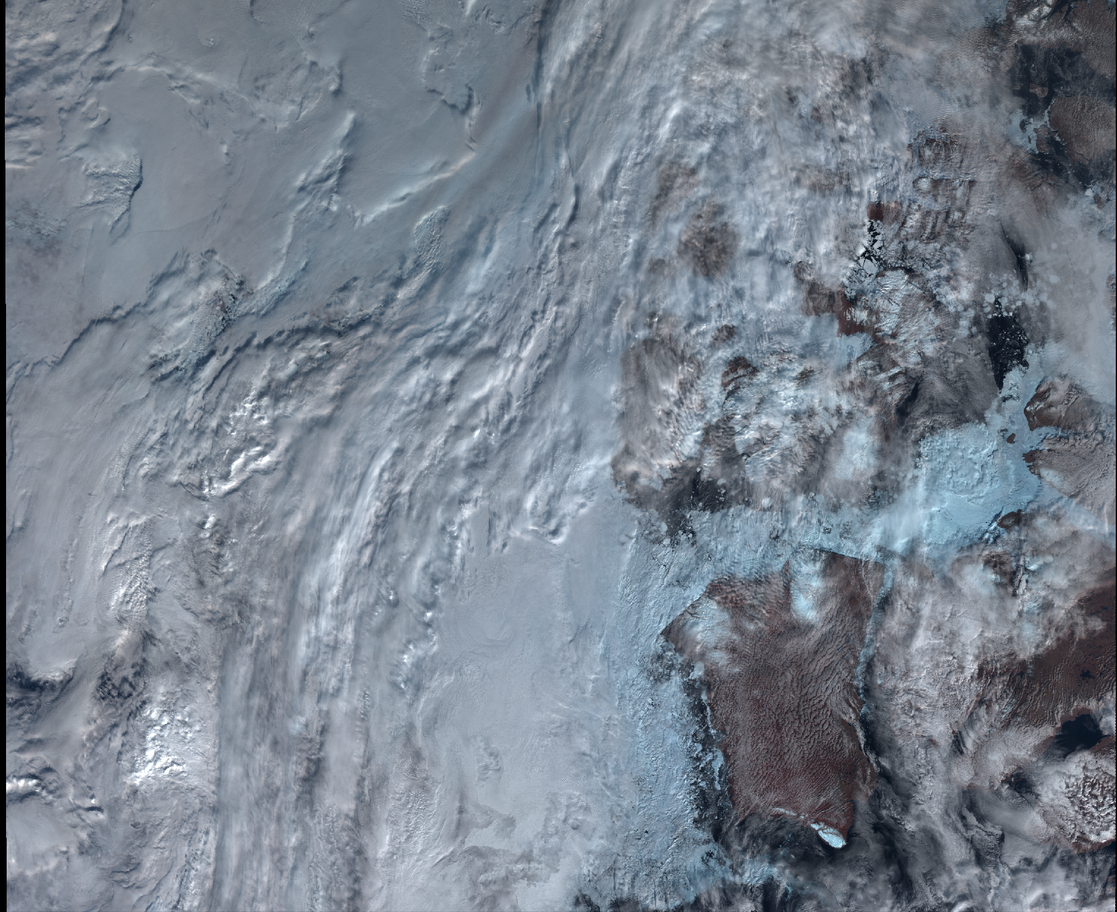
Summary
Aim
Data
Example plots
Accuracy
Reproducibility
Application speed
Future directions
Housekeeping

Slide 3
1. Aim
Identify clouds in satellite images between 60 and 90° absolute latitude using machine learning.
Artificial Neural Networks (ANN)
Deep Feed Forward Network (FNN) or Multi-Layer Perceptron (MLP)
Making predictions on SLSTR images (Sentinel 3A and B)
Training the model using CALIOP data (CALIPSO)

Slide 4
2. Data

Slide 5
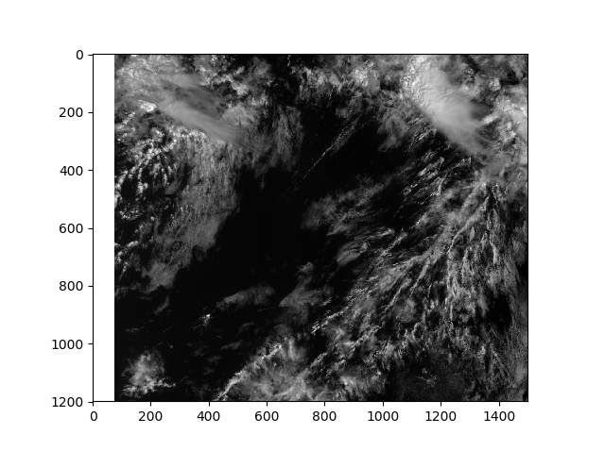
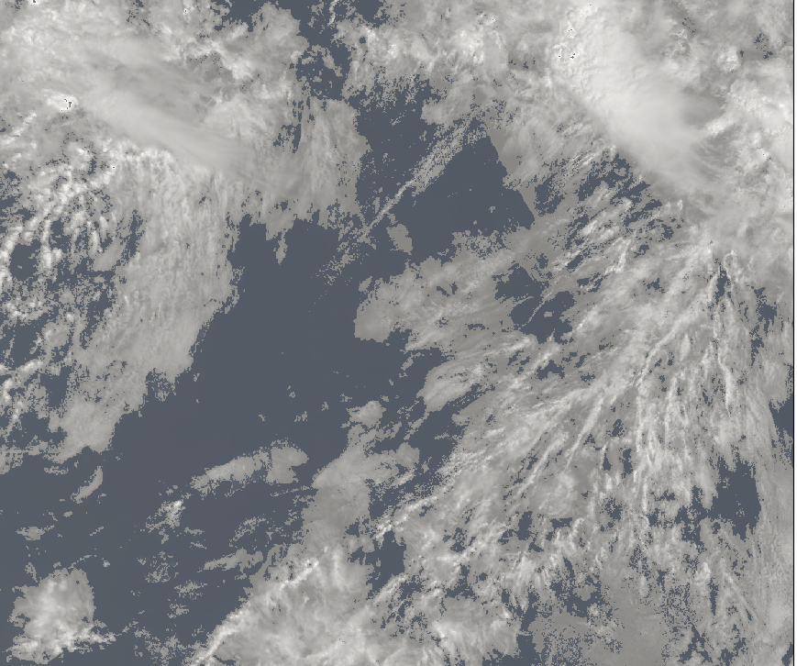
3. Example plots
Left: Generated mask
Right: S1_an channel data

Slide 6
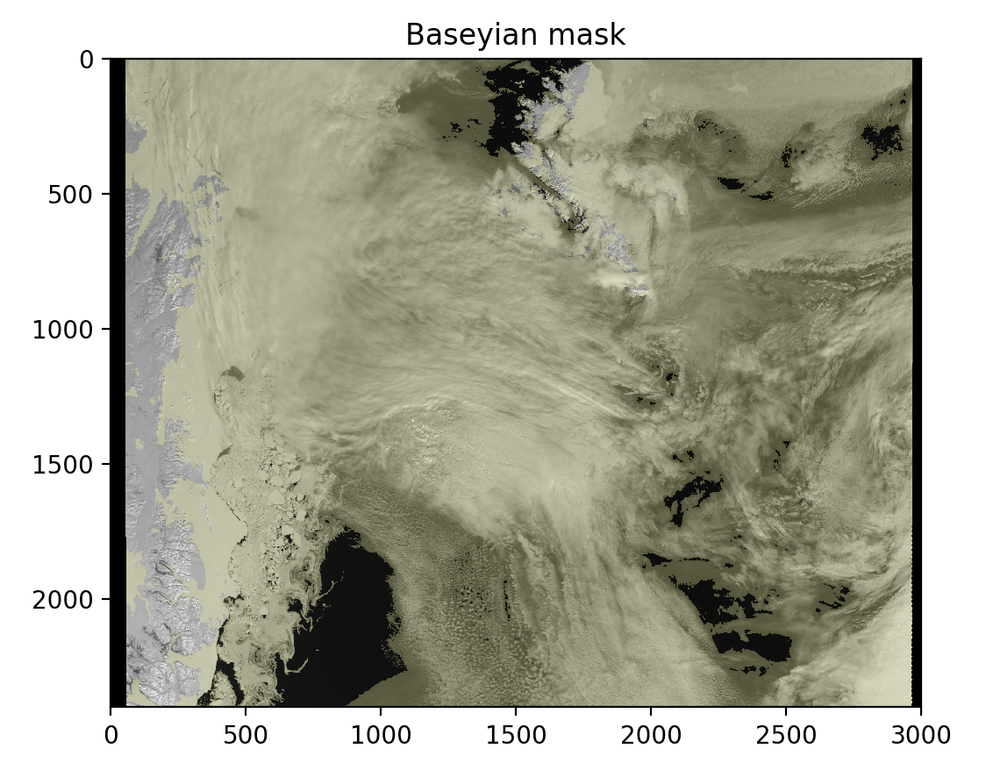
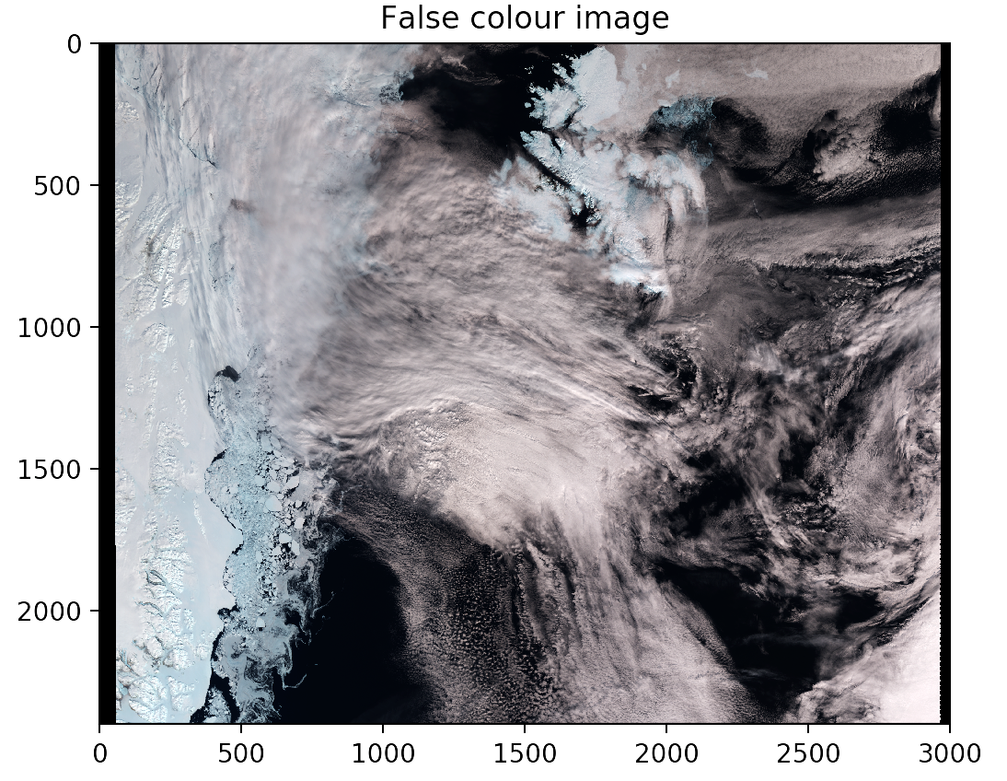
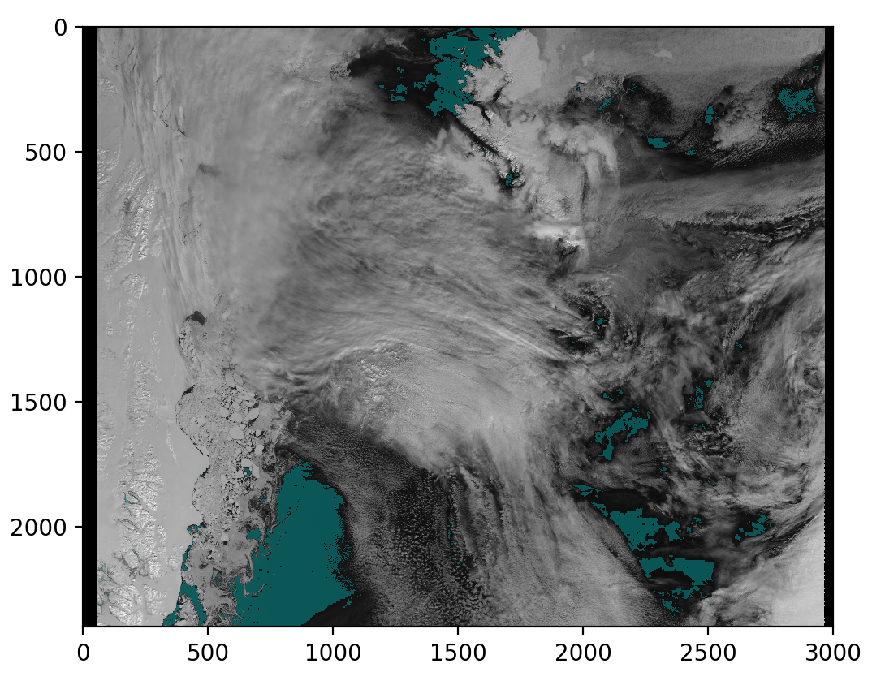
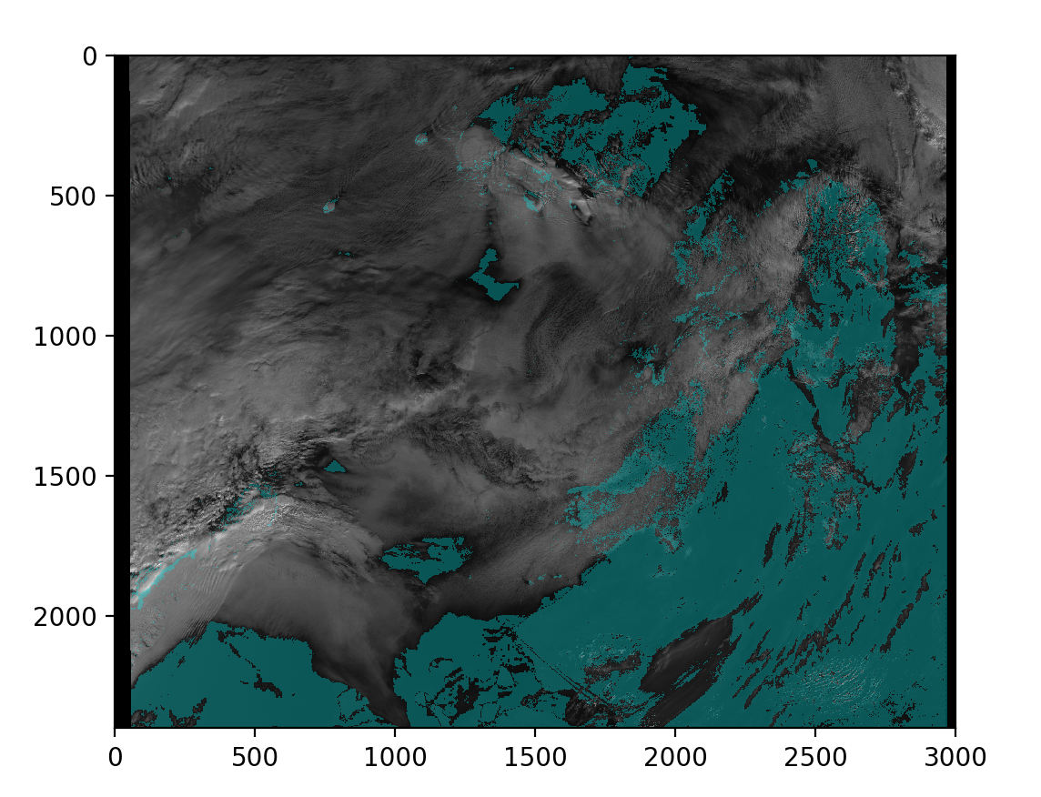
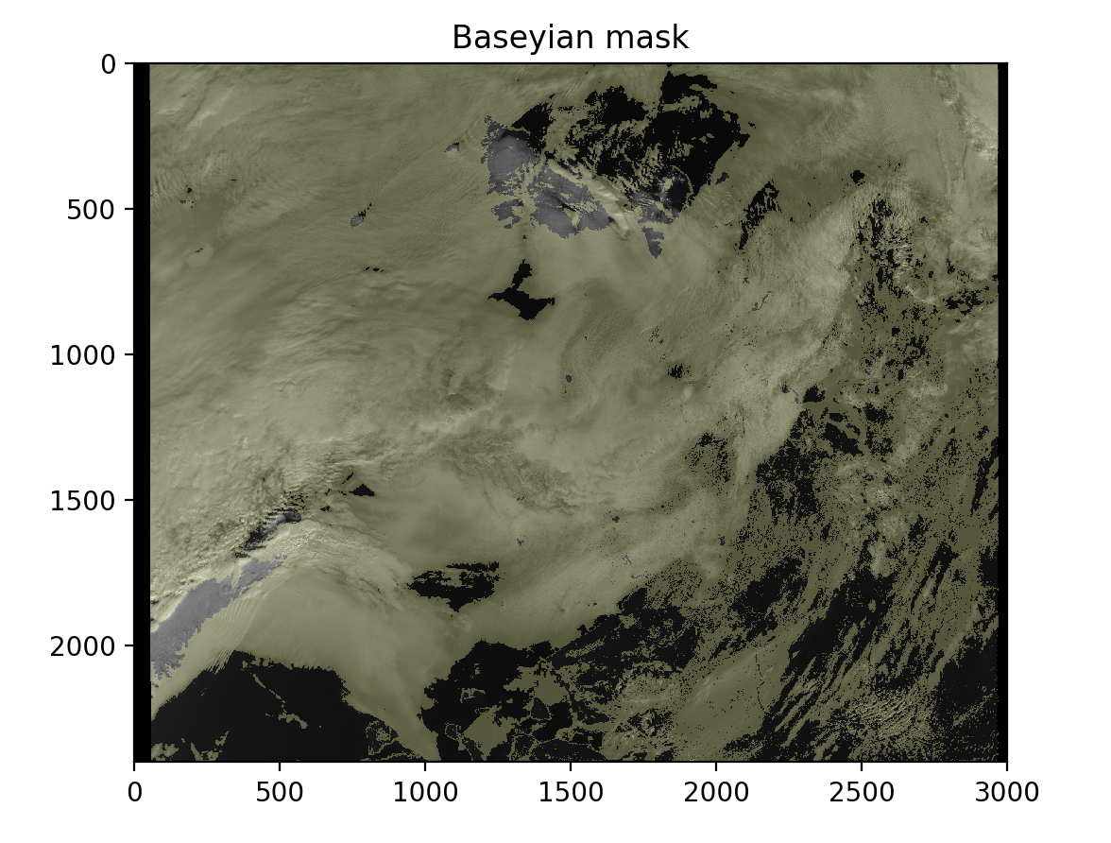
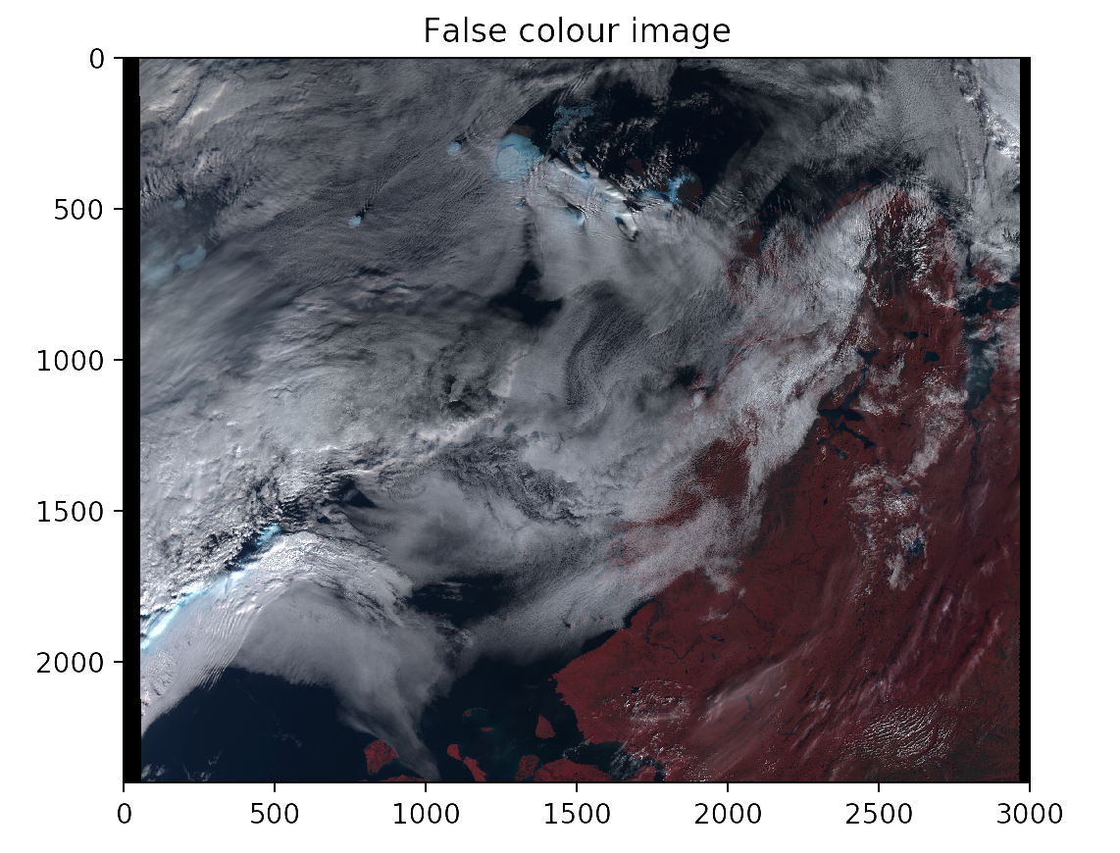

Slide 7
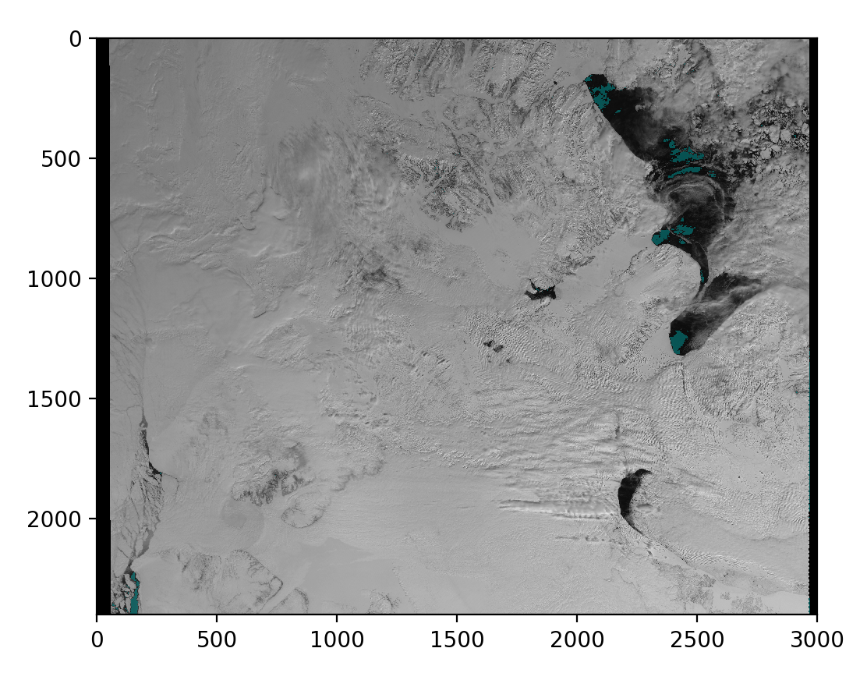
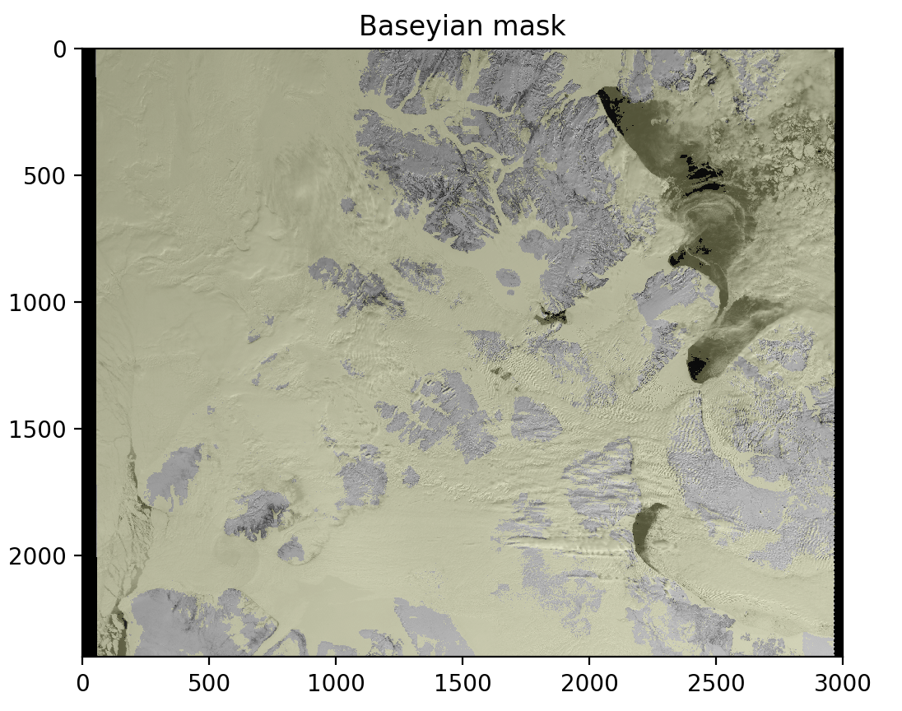
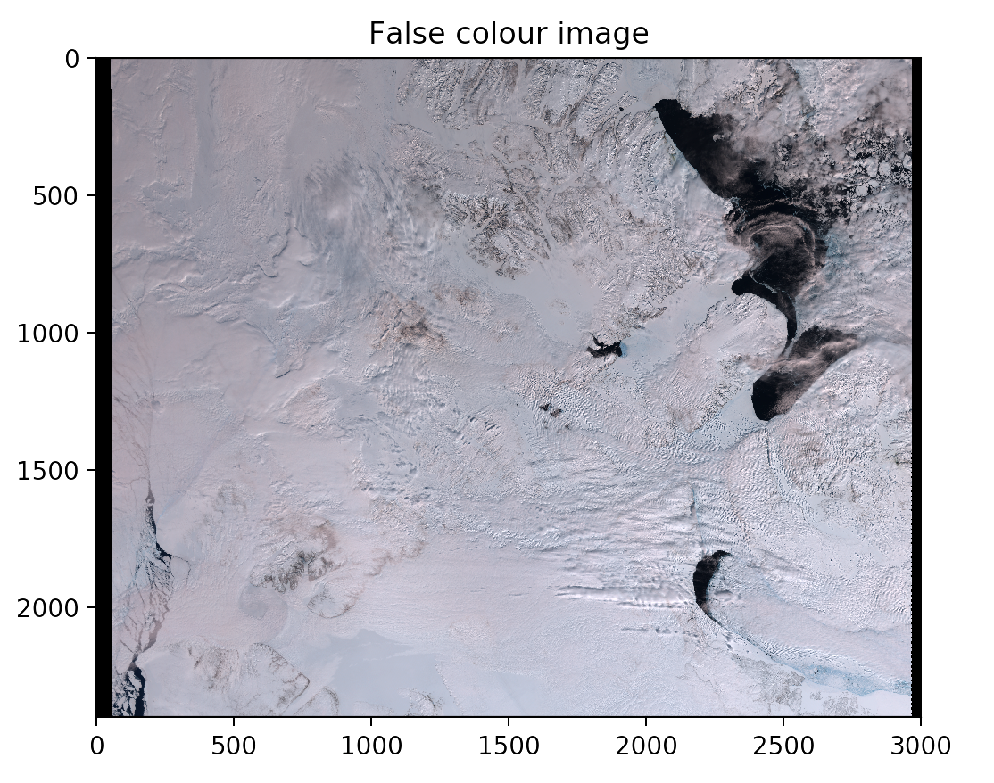
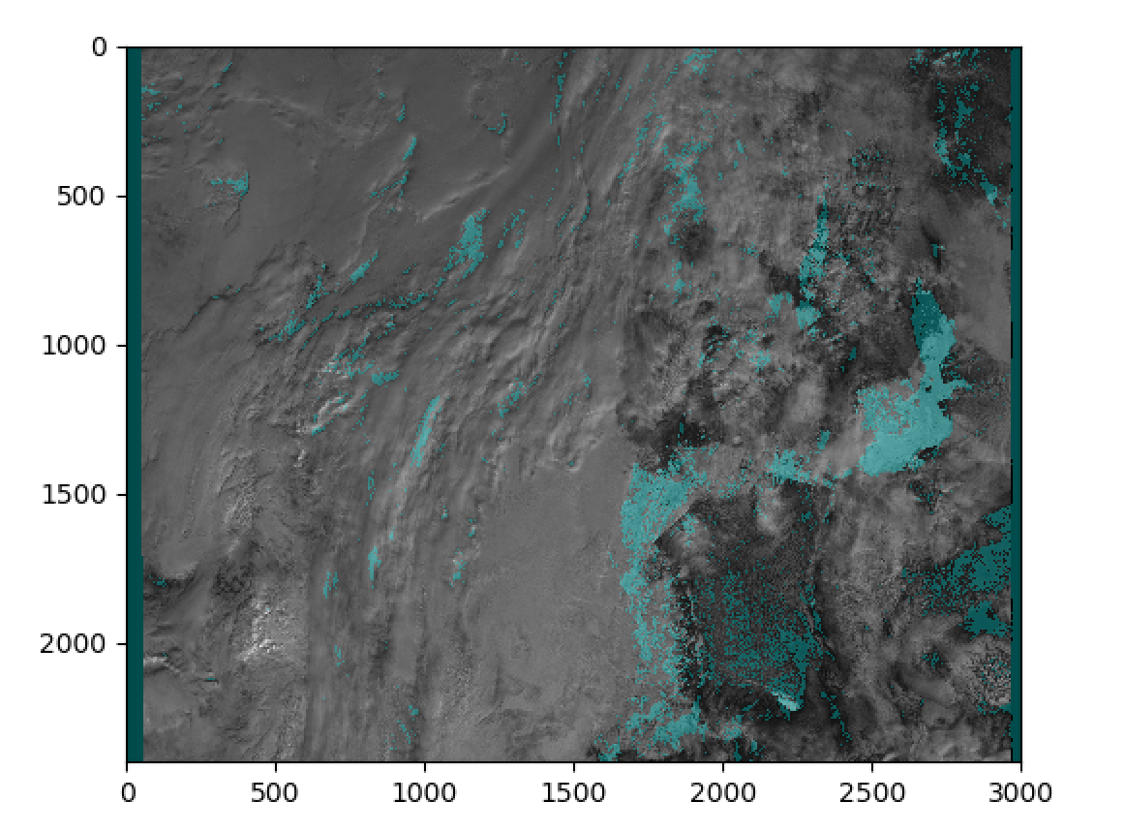
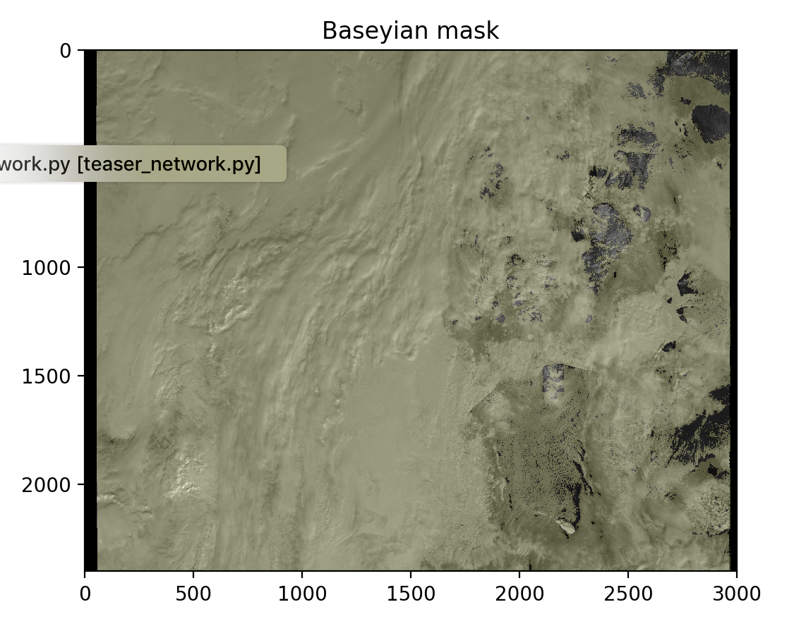
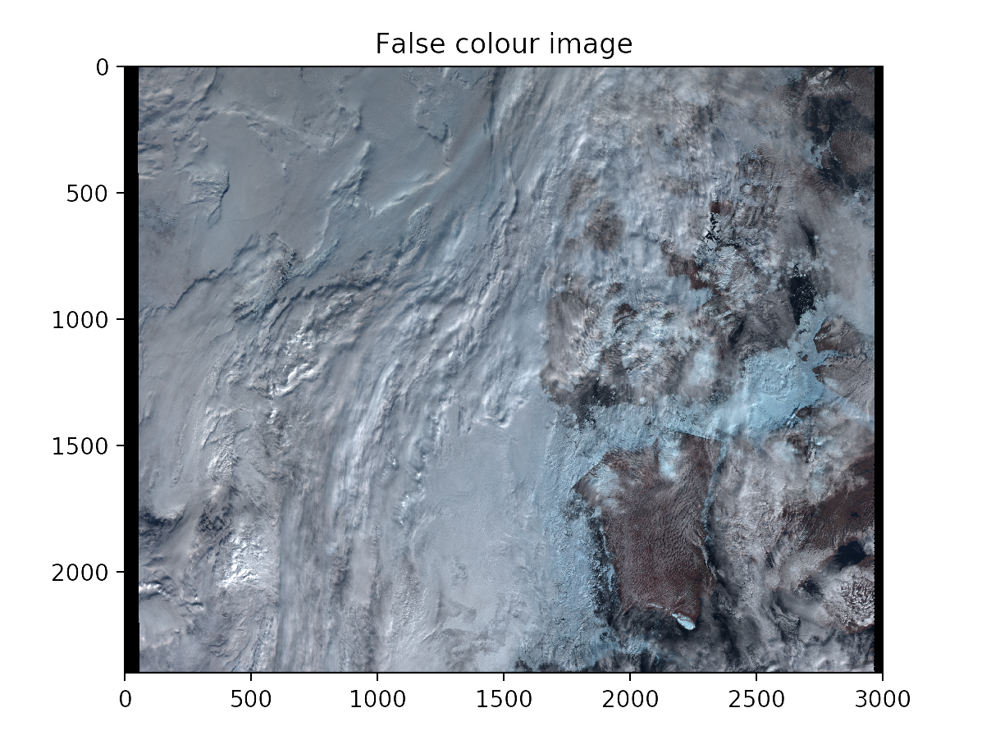

Slide 8
4. Accuracy

Slide 9
5. Reproducibility

Slide 10
6. Application speed

Slide 11
7. Future directions
Create a Convolutional Neural Network (CNN) to take into account

Slide 12
8. Housekeeping
We are free next term:
Monday morning
Tuesday between 2 and 5pm
Wednesday (all day except 11 to 12 pm)
Thursday after 2pm
Friday morning
Last meeting with Prof Egede Tuesday at 2pm

